Slide 1
aetherfire
project proposal

Slide 2
Overview
Concept
Flow
Game assets
Main characters
Story
Gameplay
Graphics and styling
Music & sound effects
Technical descriptions

Slide 3

Concept
A first-person shooter (FPS) where the player attacks a central light ball within a hanging garden in the middle of the sky after surviving from waves of AI agents. Winning depends on whether the lighting ball collapsed.

Slide 4
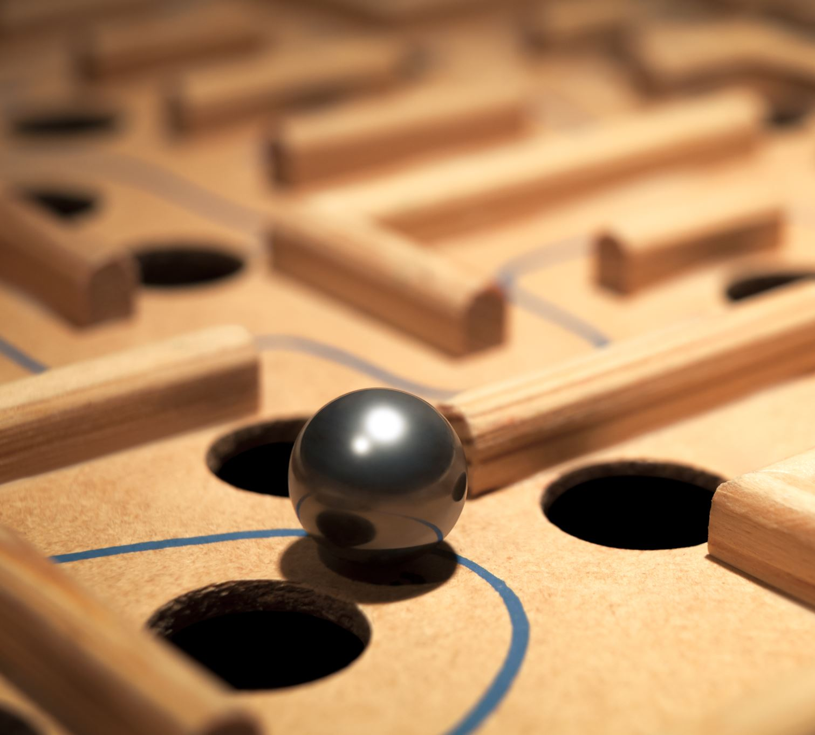
Flow
Start: Player spawns within the hanging garden.
Wave Spawning: AI agents spawn and begin navigating (flying) towards the player.
Combat: Player engages the AI agents using ranged weapons.
Light Ball Degradation: The light ball's intensity diminishes as agents attack it or get close.
Wave Completion/Failure: The player succeeds if they eliminate all agents and then attack the ball successfully. The player fails if the light ball is still alive.

Slide 5
Main characters & Story
The player: The defender of the light ball.
AI agents: The ones attempting to attack you and prevent you from attacking their light ball.
The light ball is a vital energy source, and the agents are creatures who need to protect it.

Slide 6
Assets
Garden: 3-level hanging garden environment.
Light Ball: Central glowing orb with dynamic light effects.
AI Agents: Enemy characters.
Weapons: Laser, plasma guns.
Particles: Visual effects for explosions, light ball degradation, and agent destruction.

Slide 7
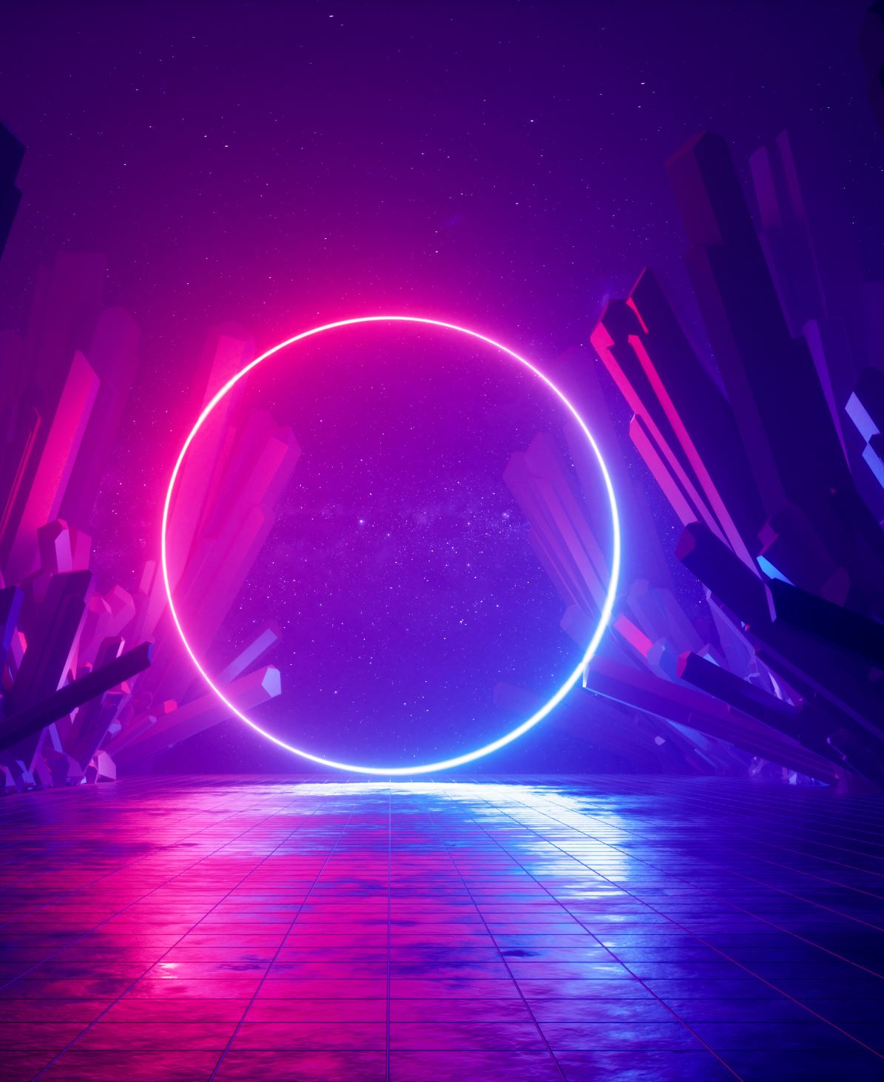
Graphics and styling
Sci-Fi aesthetics: The concept lends itself well to a futuristic aesthetic.

Slide 8
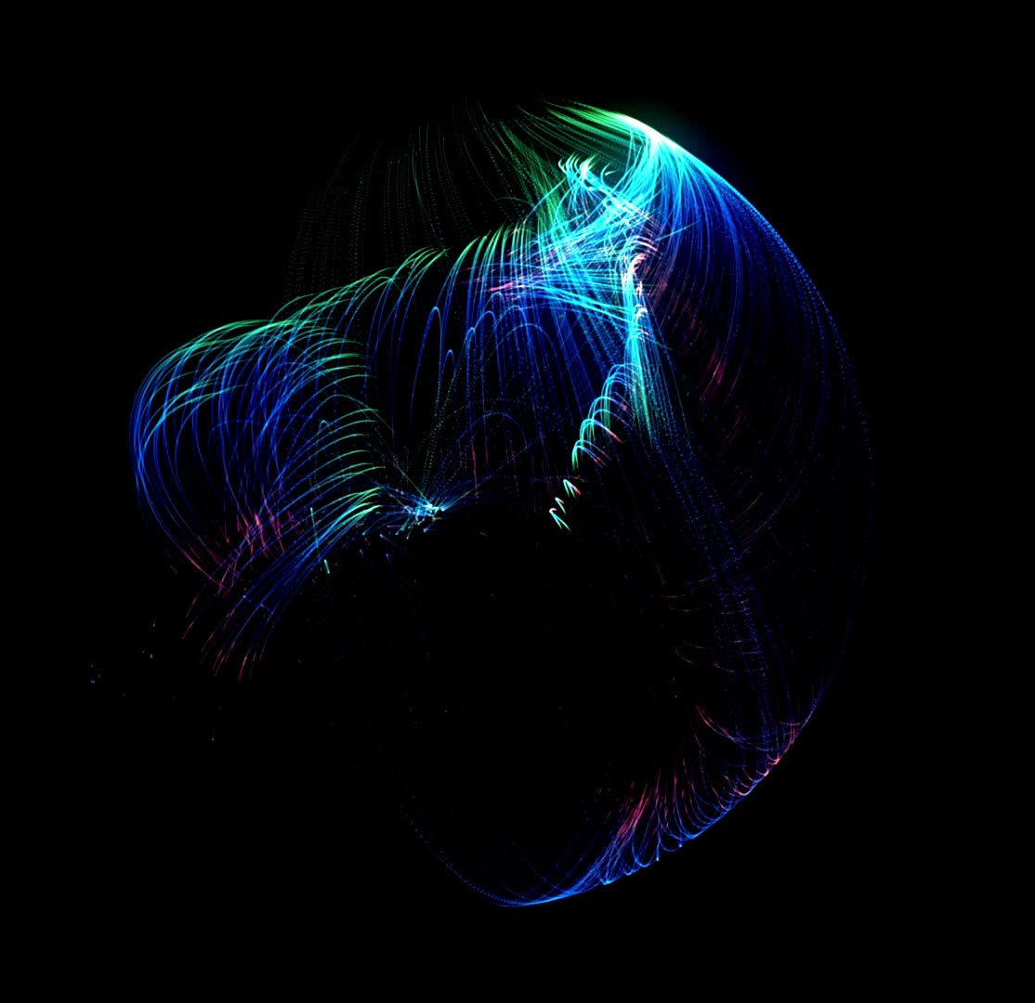
Music & Sound effects
Intense Music: Fast-paced electronic or synth-based music to build tension and excitement.
Sound Effects: Weapon fire, agent noises, explosions.

Slide 9
Technical Descriptions
Game Engine: Unity
AI Pathfinding: Unity’s AI NavMesh.
Lighting: Dynamic lighting and shaders’ effects to enhance the atmosphere and visualize the light ball's degradation.
Collision Detection: Collision detection for weapons fire and agent interactions.

Slide 10
Thanks for watching

